Slide 1


Embedded DevOps (EmbDevOps)
KTE between TU Clausthal and Pikei

Slide 2

Our partner pikei
Consultancy and solution provider from Patras
Many topics from frontend/backend development to embedded systems and DevOps
Latest project “Wine Safe Net (WSN) Platform“ including modern blockchain solution and embedded devices

Slide 3
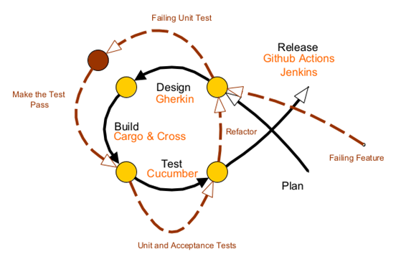
BDD Cycle and Design
BDD tests with Gherkin language for behaviour description and Cucumber feature files as framework
Each greater functionality has its own feature and file
Unit tests in Rust code with[\#test]macros
In the same file that contains the functions that are tested
Ensure the correctness of important functions
Additional testing with Rust doc-strings

Slide 4
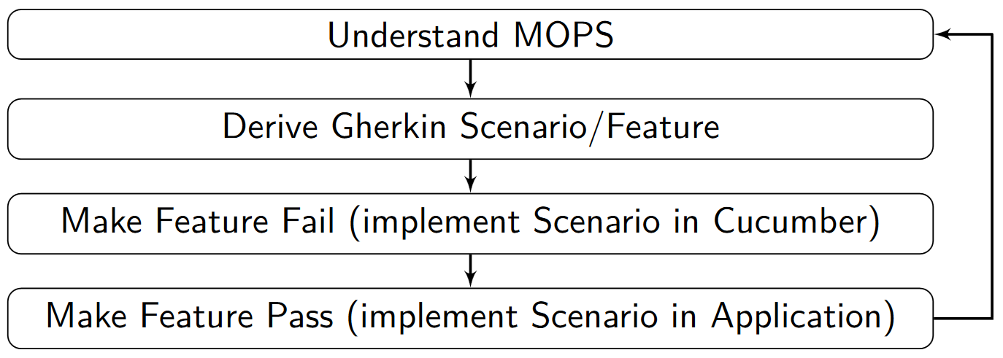
BDD Cycle

Slide 5
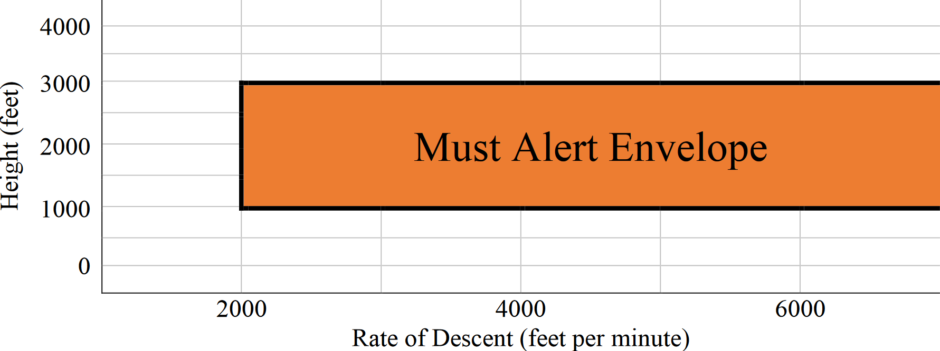
Understand MOPS
A simplified variant of MOPS_269 from DO-367
Class C Equipment shall (MOPS_269) provide a caution alert when Mode 1 is armed and the combination of rate of descent and height above terrain is within the Must Alert envelope prescribed in the figure below.

Slide 6
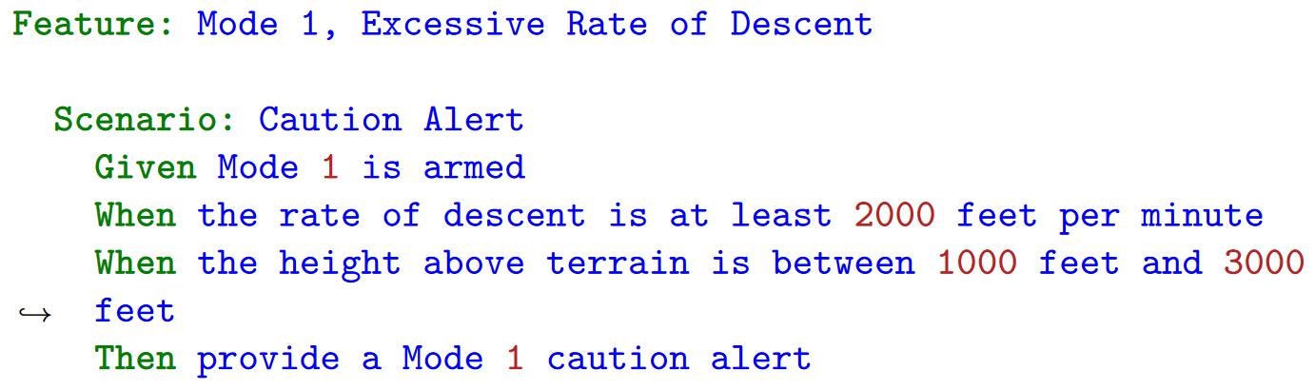
Derive Gherkin Scenario

Slide 7
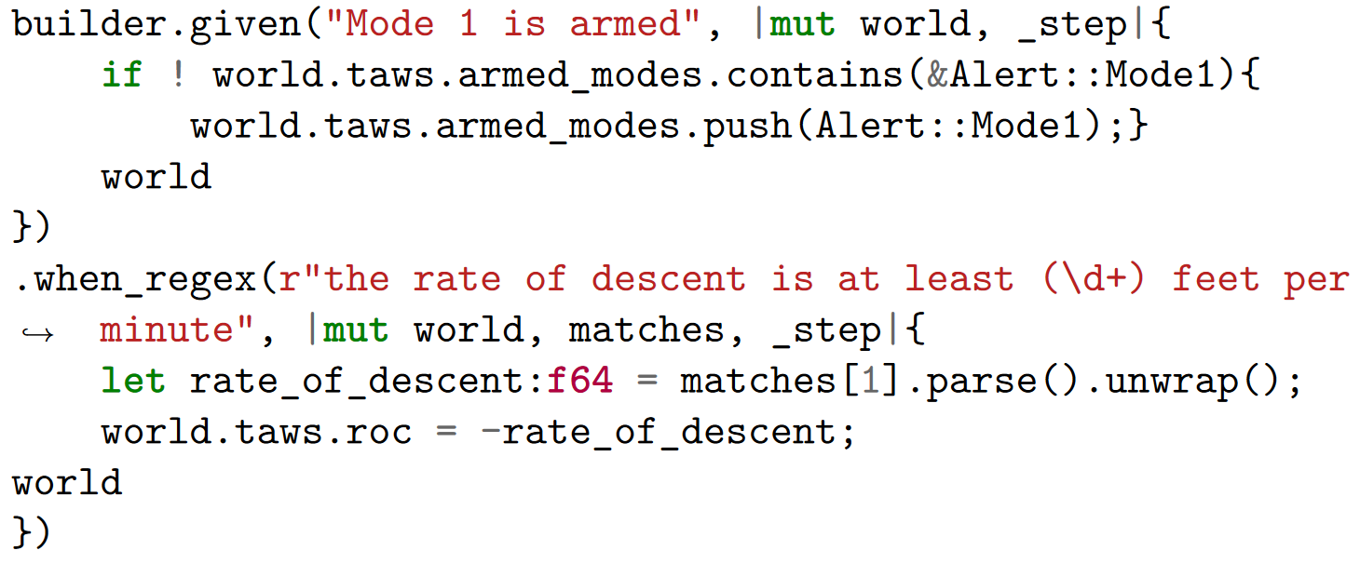
Implement Scenarios in Cucumber I

Slide 8
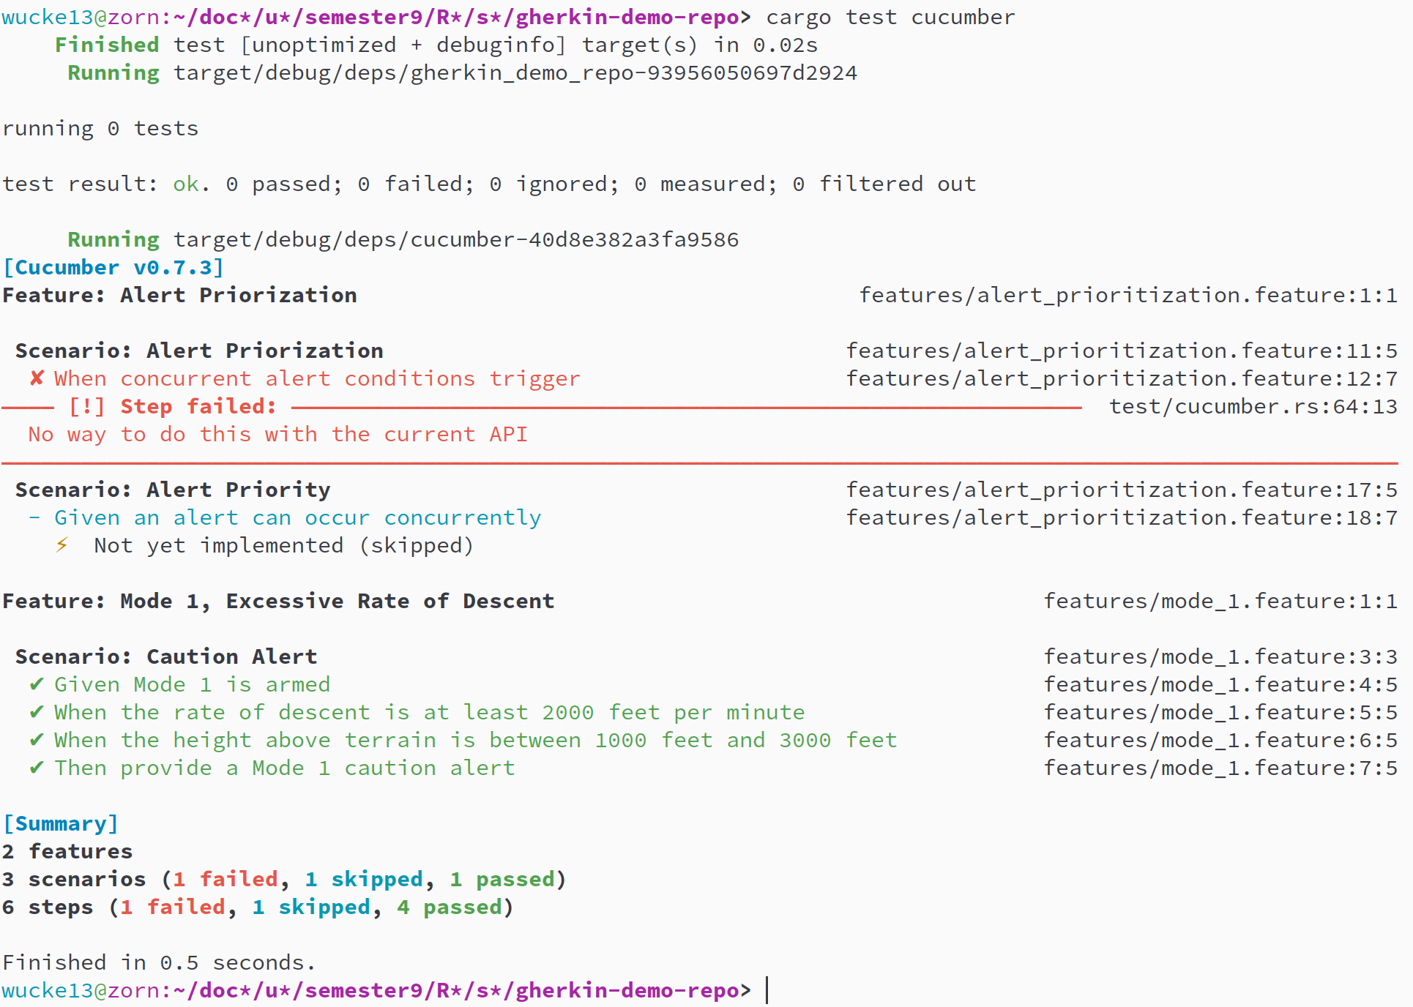
Generate Report

Slide 9
Jenkins Testing
Docker agent containing Rust and Cargo
Officially maintained images available from dockerhub
Building, testing and utility with shell Cargo commands
No prepared commands or macros like Github actions

Slide 10
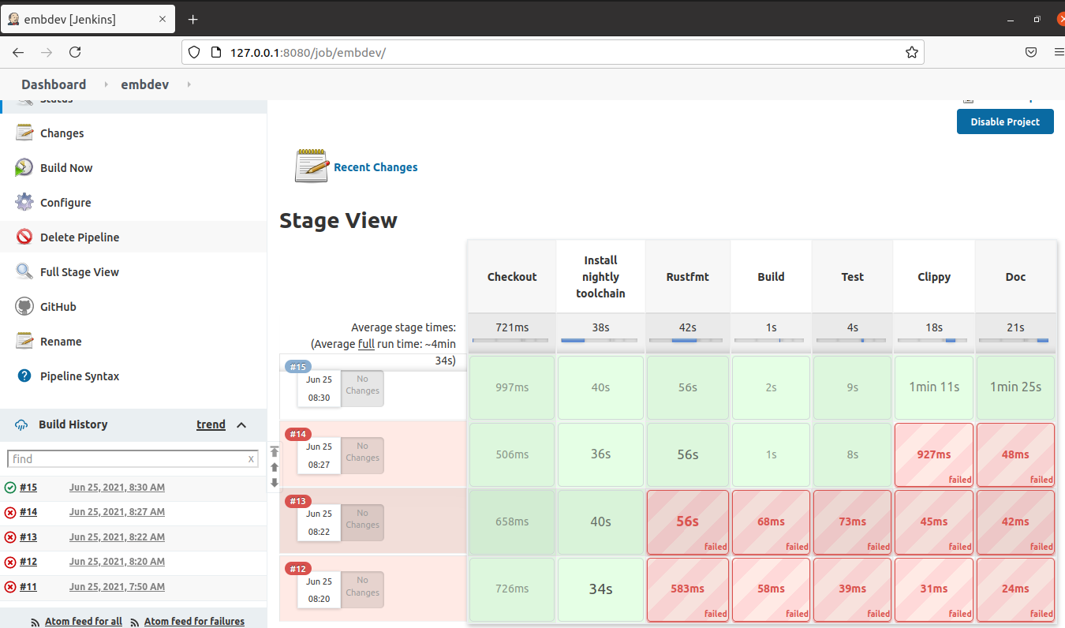
Jenkins Execution

Slide 11
Test with QEMU
Using Rust cross from the rust-embedded project
Encapsulated QEMU environment to build and test software project
Available with simple parameter in Github Actions use­-cross: true
Replaces the cargo command for shell commands i. e. in Jenkins
cross build --target aarch64-unknown-linux-gnu
cross test --target mips64-unknown-linux-gnuabi64
cross run --target aarch64-unknown-linux-gnu
Supports many targets with most of them being testable
Available in standard Rust docker image

Slide 12
Project goals
Demonstrator provides capability to exemplify DevOps in embedded systems domain
Agile and responsive application development approach for embedded systems through BDD
Enhanced consultancy services with new competence
New BDD approach is expected to be used in new project including blockchain solution with embedded devices and Rust

